Slide 1


INNOVATIVE LEARNING SOLUTIONS
Adaptive Learning System
Presented by :
312822104012 Baskar B
312822104029 Hariharan I
312822104047 Kabilesh R M
312822104048 Kamalesh K
312822104064 Manoj kumar M

Slide 2
Project Objectives
Key Goals for Success
Attention Tracking
Cognitive Load
Adaptive Content
Utilizing webcam technology, we can accurately monitor learners' focus levels, ensuring that engagement is optimized and helping identify when students may need support or encouragement.
By estimating cognitive load through facial features and gaze patterns, the system can adapt content difficulty, avoiding cognitive overload and allowing learners to progress at their optimal pace.
The system intelligently personalizes learning paths by adjusting content based on real-time feedback, ensuring that each learner receives tailored support to maximize understanding and retention.

Slide 3

Methodology Overview
Visual Pipeline of Adaptive Learning System
This section illustrates the interconnected components of the adaptive learning system, showcasing how cognitive load estimation and attention tracking integrate seamlessly to enhance personalized learning experiences in real-time.

Slide 4


Data Capture
Webcam Face Detection
This system utilizes webcam-based technology to detect facial features and track gaze, enabling real-time assessment of user engagement and cognitive load during learning activities.

Slide 5
Feature Extraction
Blink Rate
Head Pose
Measuring blink rate helps assess user engagement, as increased blinking may indicate cognitive overload or distraction during learning sessions.
Analyzing head pose assists in understanding user attention direction, allowing the system to adapt content based on where the learner is looking.
Gaze Stability
Pupil Approximation
Gaze stability indicates how consistently a learner focuses on specific content, affecting their ability to absorb and retain information effectively.
Tracking pupil size variations provides insights into cognitive load, as pupil dilation often correlates with mental effort and emotional responses during learning.

Slide 6

Cognitive Load Estimation
LSTM and Random Forest
Cognitive load estimation is crucial for personalized learning. Utilizing advanced algorithms like LSTM and Random Forest allows for accurate assessment of learners' cognitive states in real-time.

Slide 7
Attention Classification
Tracking Focus and Distraction
Focused Attention
Distracted Behavior
Drowsy State
Focused attention indicates a high level of engagement and processing. Our system measures eye contact and gaze direction to determine when learners are fully involved in their tasks.
When distraction occurs, the system detects deviations in gaze and attention metrics. This information helps educators intervene and adjust content to recapture learner focus and attention.
The system identifies drowsiness through changes in blink rates and facial expressions. Recognizing this state allows for timely adjustments, ensuring learners remain alert and receptive throughout the learning experience.

Slide 8
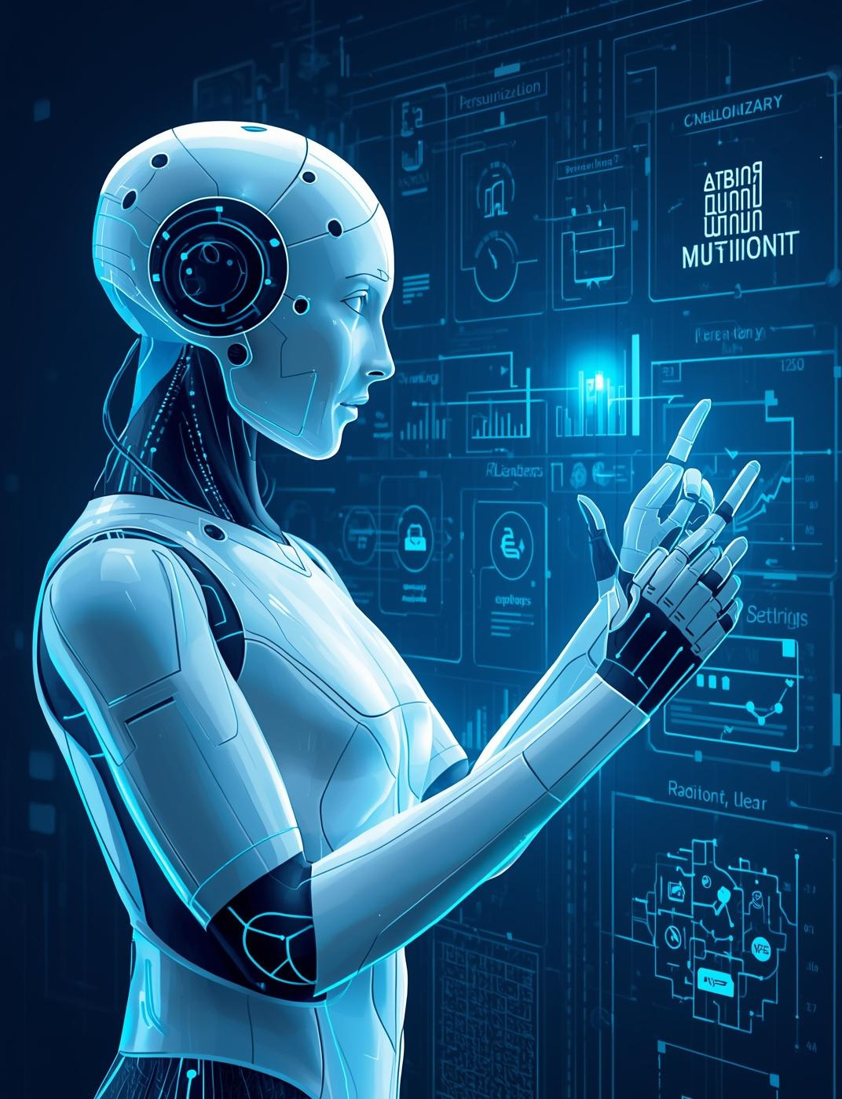
Adaptive Learning Engine
Personalizing the Experience
The adaptive engine intelligently adjusts learning difficulty, provides tailored hints, and offers summaries, enhancing user engagement and optimizing retention based on real-time cognitive assessments.

Slide 9
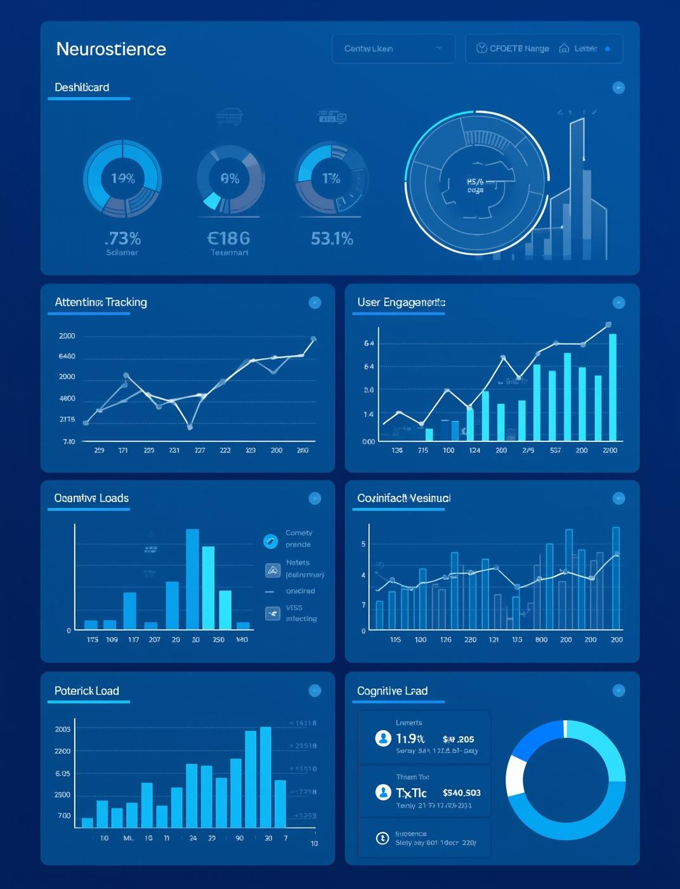
Visualization & Feedback
Dashboards for Analysis
Interactive dashboards visualize user performance and engagement, enabling educators to adapt learning materials based on real-time data, enhancing student retention and overall effectiveness.

Slide 10
References and Resources
  E. Bozkır, D. Geisler, and E. Kasneci, “Person-independent, privacy-preserving, and real-time assessment of cognitive load using eye tracking in a virtual reality setup,” Proc. 2019 IEEE Conf. on Virtual Reality and 3D User Interfaces (VR), Osaka, Japan — IEEE Xplore link: https://ieeexplore.ieee.org/document/8797758
  "Review of Eye Tracking Metrics Involved in Emotional and Cognitive Processes" - Authors : Vasileios Skaramagkas; Giorgos Giannakakis; Emmanouil Ktistakis; Dimitris Manousos; Ioannis Karatzanis; Nikolaos S. Tachos
IEEE XPLORE link: https://ieeexplore.ieee.org/document/9380366

